Slide 1
Heart disease prediction using hybrid ML algorithm.
Chhavi Jain
20BKT0144
Under the guidance of
Prof. RAJKUMAR S

Slide 2
Aim
To rigorously evaluate and compare various machine learning classifiers for their effectiveness in predicting the presence of heart disease using clinical data from reputable institutions.
By identifying the most reliable predictive models through systematic analysis, this project aims to advance the integration of machine learning techniques into cardiovascular disease management, enabling healthcare professionals to make informed decisions and enhance patient outcomes.

Slide 3
Problem Statement

Slide 4
The primary challenge addressed by this project is the inefficiency and complexity of conventional cardiac disease detection methods, which often rely on expensive and time-consuming diagnostic tests and subjective expert judgment.
The goal is to leverage machine learning techniques to enhance the precision and efficiency of heart disease detection by analyzing diverse clinical data sources. Specifically, this study aims to evaluate and compare the performance of multiple machine learning algorithms in accurately predicting the presence of cardiac disease.
By identifying the most effective models under various conditions, the project seeks to develop automated prediction tools that can aid medical professionals in early diagnosis and decision-making for the management and treatment of cardiac illness.
Ultimately, this project aims to address the need for advanced diagnostic tools in cardiology through the application of machine learning, potentially reducing costs and time associated with traditional diagnostic procedures.

Slide 5
Module Description

Slide 6
Logistic Regression:
Description: Predicts binary outcomes using a linear combination of input features.
Configuration: Implemented with L2 regularization to prevent overfitting. Regularization strength was optimized using cross-validation.
Support Vector Machines (SVM):
Description: Finds the optimal hyperplane to separate classes, effective in high-dimensional spaces.
Configuration: Tested with linear and radial basis function (RBF) kernels. Parameters (𝐶 and 𝛾) were optimized through grid search.
Random Forest:
Description: Ensemble method using decision tree classifiers to improve prediction accuracy.
Configuration: Tuned hyperparameters including number of trees, maximum tree depth, and minimum samples required to split a node.

Slide 7
Gradient Boosting Classifier:
Description: Builds models sequentially to correct errors made by previous trees, known for high predictive accuracy.
Configuration: Optimized parameters like number of boosting stages, learning rate, and tree depth. Tested with different loss functions.
Voting Classifier:
Description: Aggregates predictions from multiple models using majority voting for robust performance.
Configuration: Configured with a combination of models (e.g., Logistic Regression, SVM, Random Forest). Tested both hard voting (class labels) and soft voting (probabilities) strategies.

Slide 8
System Architecture

Slide 9
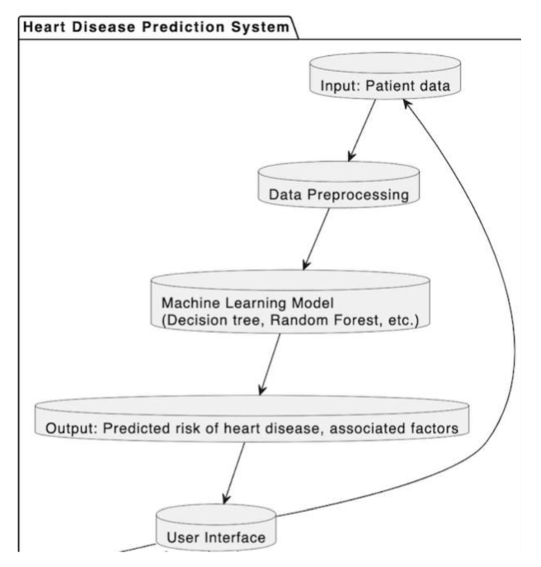

Slide 10
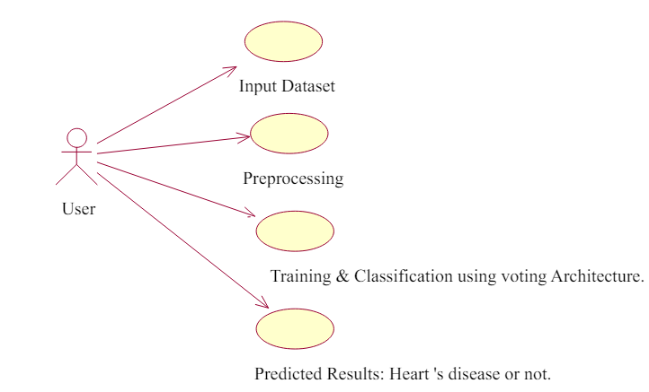

Slide 11
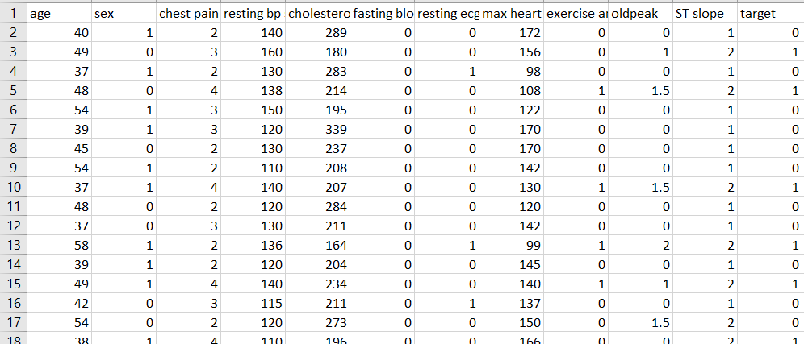
Dataset:

Slide 12
SOFTWARE REQUIREMENTS:
Operating System: Windows 10, macOS Mojave, or any popular distribution of Linux (e.g., Ubuntu 18.04 or later).
Python Environment: Python 3.8 or later supports all required libraries.
Main Libraries:
Pandas (version 1.1 or later) for data manipulation.
NumPy (version 1.19 or later) for numerical operations.
Scikit-learn (version 0.24 or later) for machine learning algorithms and model
evaluation.
Matplotlib and Seaborn for data visualization.
Plotly for interactive visualizations.
Jupiter Notebook or JupyterLab for executing Python code in an interactive notebook format.

Slide 13
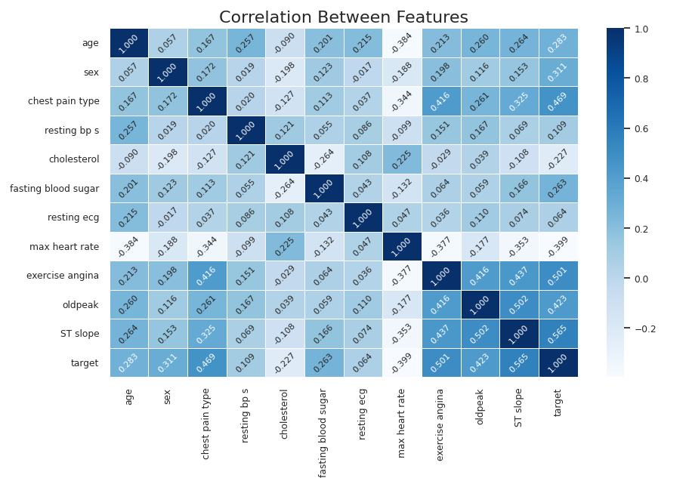
Model Testing
Here are some of the classification reports for different AI algorithms and models.
Correlation matrix:

Slide 14
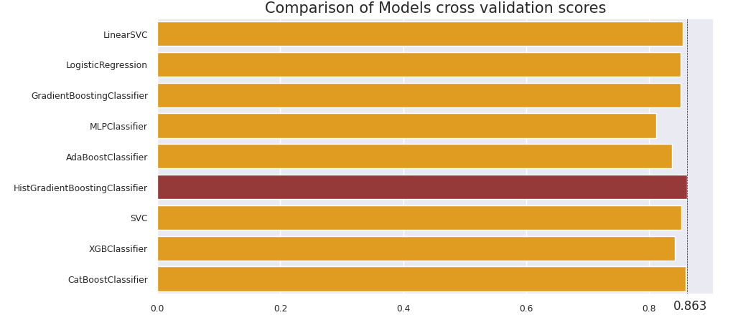

Slide 15
Result:
Each model was evaluated based on several performance metrics including accuracy, precision, recall, F1-score, and the area under the ROC curve (AUC). These metrics provide insights into the effectiveness of each model in handling the prediction task.
Model Performance Summary:
Logistic Regression: Achieved an accuracy of approximately 81.15%, with a precision of 86% and a recall of 90%. The model displayed moderate performance in distinguishing between the classes.
Support Vector Machine (SVM): The SVM with a linear kernel performed slightly better with an accuracy of 85%.
Gradient Boosting Classifier: Exhibited high precision and recall, with overall accuracy reaching 85%. The model's strength was in its predictive consistency across different subsets of the dataset.
Voting Classifier: The ensemble approach used in the Voting Classifier, combining using Gradient Boosting and CatBoost classifiers resulted in an improved overall accuracy of 90.44% showcasing the effectiveness of model aggregation.

Slide 16
Comparative Analysis
The Voting Classifier outperformed individual models in terms of overall accuracy and stability across different metrics. CatBoost classifiers and Gradient Boosting showed high effectiveness in handling imbalanced data, which is typical in medical diagnostic datasets. Logistic Regression and SVM, while less complex, provided valuable baseline information but were outperformed by more sophisticated ensemble techniques.
What are catboost classifiers?
CatBoost, or Categorical Boosting, is an open-source machine learning algorithm that uses decision trees for classification and regression. It's a variant of gradient boosting that can handle both categorical and numerical features without preprocessing.

Slide 17
THANK YOU

